Slide 1
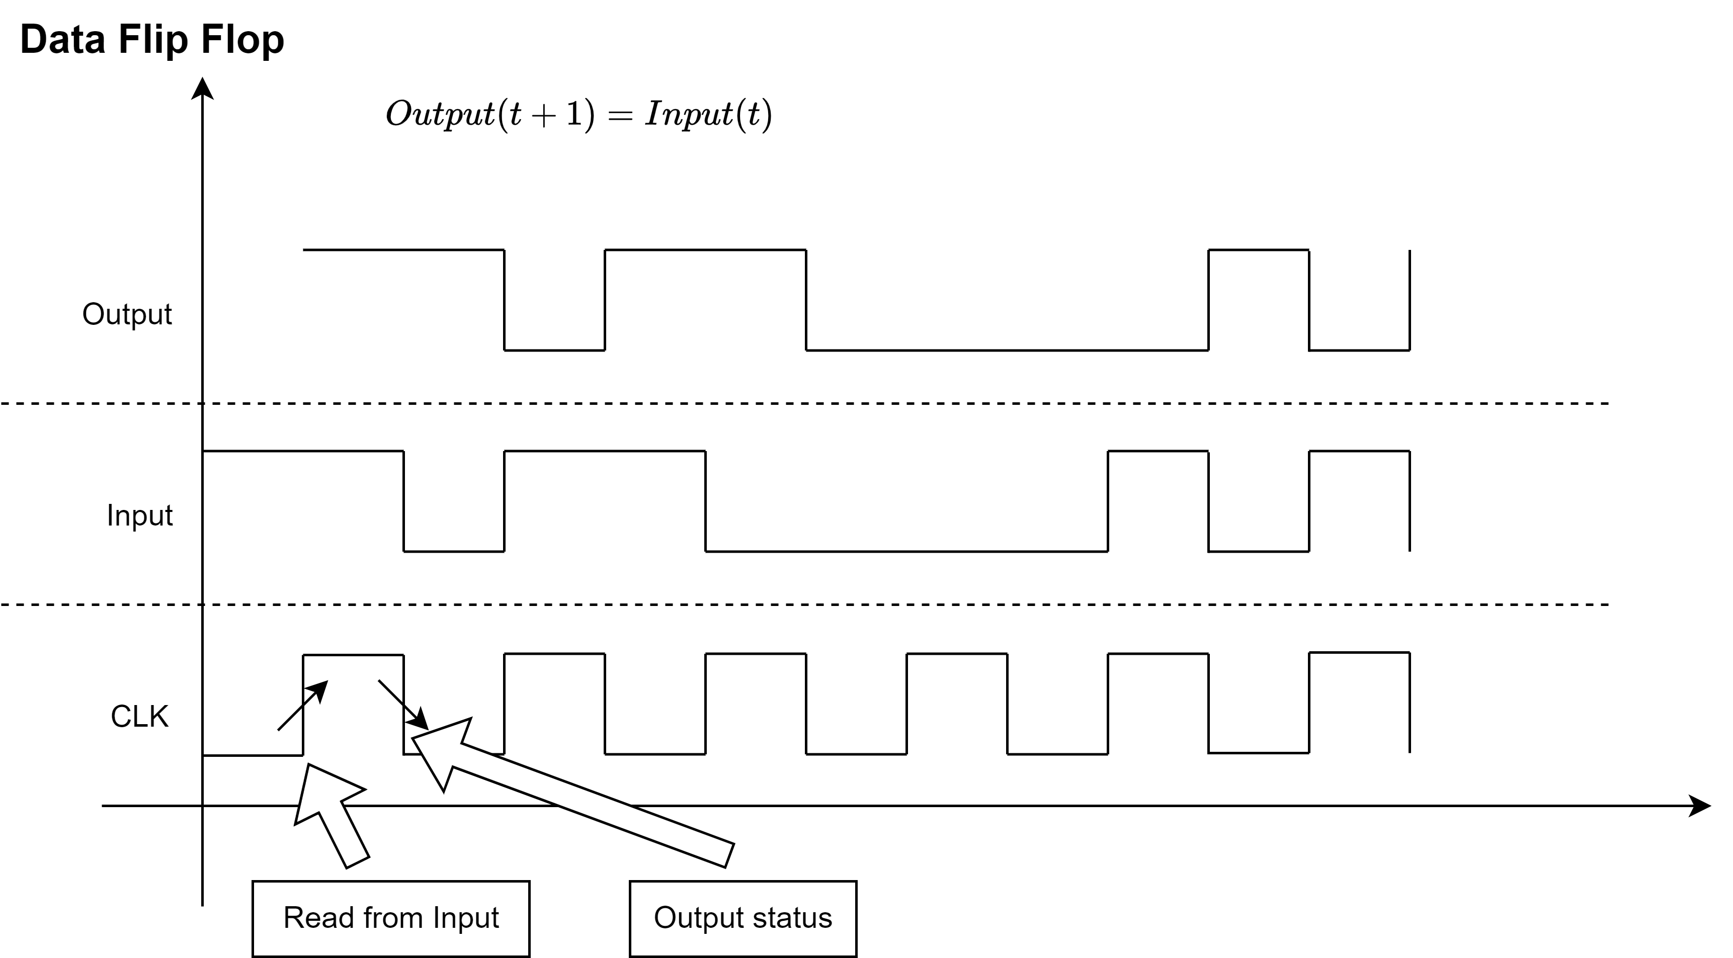

Slide 2
Atom Gates
Basic
AND16
Mux16
DMux4Way
Mux4Way16
NAND
AND, OR, NOT, XOR
OR16
OR8Way
DMux8Way
Mux8Way16
DFF
Mux, DMux
NOT16
input | sel | output1 | output2

